Slide 1
Digital Portfolio
STUDENT NAME:
REGISTER NO AND NMID:
DEPARTMENT:
COLLEGE:
KAJENDRAN.S
F064EE7CA5788EC98AD45B942AB52B4C
B.Sc INFORMATION TECHNOLOGY
KAAMADHENU ARTS AND SCIENCE COLLEGE, SATHY

Slide 2
PROJECT TITLE
"Digital Portfolio: Showcasing Web Development Skills and Projects"

Slide 3


AGENDA
Problem Statement
Project Overview
End Users
Tools and Technologies
Portfolio design and Layout
Features and Functionality
Results and Screenshots
Conclusion
Github Link
3/21/2024 Annual Review

Slide 4

PROBLEM STATEMENT
Creating a personal portfolio to effectively showcase my skills, projects, and professional journey in web development and related technologies. The challenge was to design an intuitive, modern, and responsive layout that highlights creativity, technical abilities, and project experiences in a user-friendly manner.

Slide 5

PROJECT OVERVIEW
This portfolio is a digital resume demonstrating my passion for web development through a clean interface built with HTML, CSS, and JavaScript. It includes sections about my skills, projects like a calculator application and a blog interface design, and a contact form to facilitate communication.

Slide 6

WHO ARE THE END USERS?
The primary users are potential employers, clients, and collaborators who want to explore my capabilities and project work. The design is also suitable for other developers and learners seeking inspiration or technical references.

Slide 7

TOOLS AND TECHNIQUES
HTML5 for semantic markup
CSS3 for styling including responsive design and animations
JavaScript for dynamic interactions like smooth scrolling and form submission handling
Code editor and browser developer tools for development and debugging

Slide 8
POTFOLIO DESIGN AND LAYOUT
The portfolio features a header with navigation links for easy access to sections like Home, Skills, Projects, and Contact. The hero section welcomes visitors with a gradient background and a call-to-action button. Skills are present in visually appealing cards with hover effects. Projects are displayed as cards with shadow and color transition effects for interactivity. The contact form is simple and functional, encouraging user interaction. The design uses a consistent color scheme predominantly with blues, greens, and accent colors for highlights, focusing on readability and modern aesthetics.
8

Slide 9
FEATURES AND FUNCTIONALITY
Smooth scroll navigation between sections
Responsive layout adaptable to different screen sizes
Interactive project cards with hover animations
A contact form with client-side validation and confirmation alert on submission
Visual skill cards demonstrating expertise areas
Sticky header for constant navigation access

Slide 10
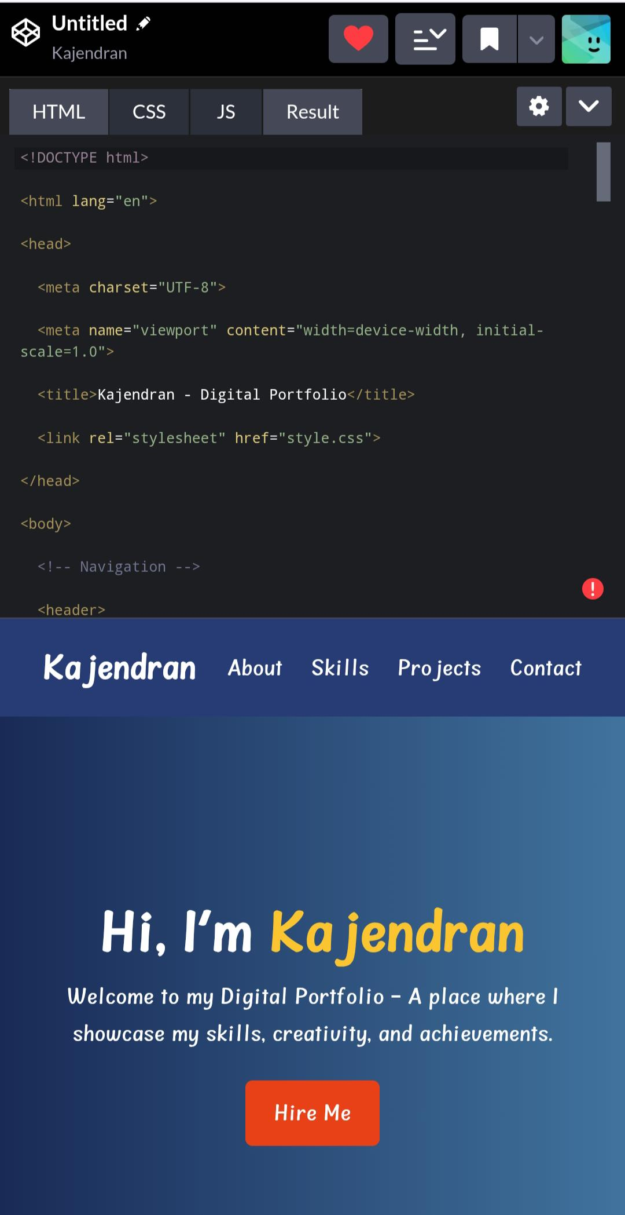
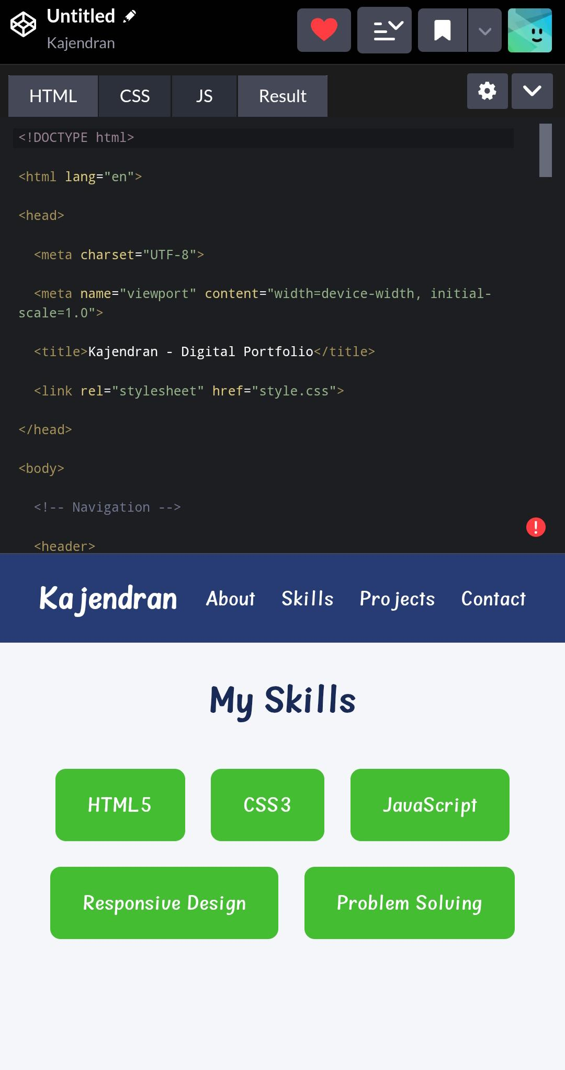
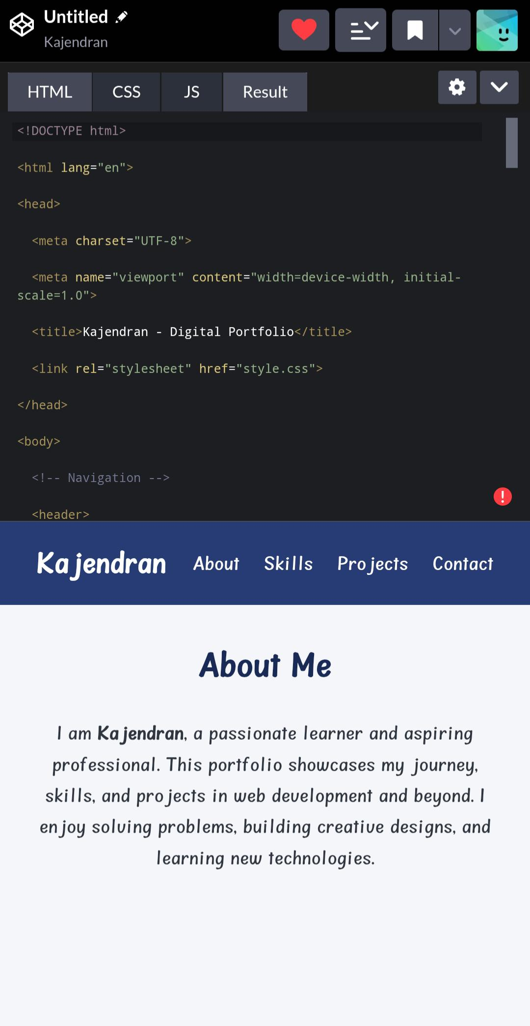
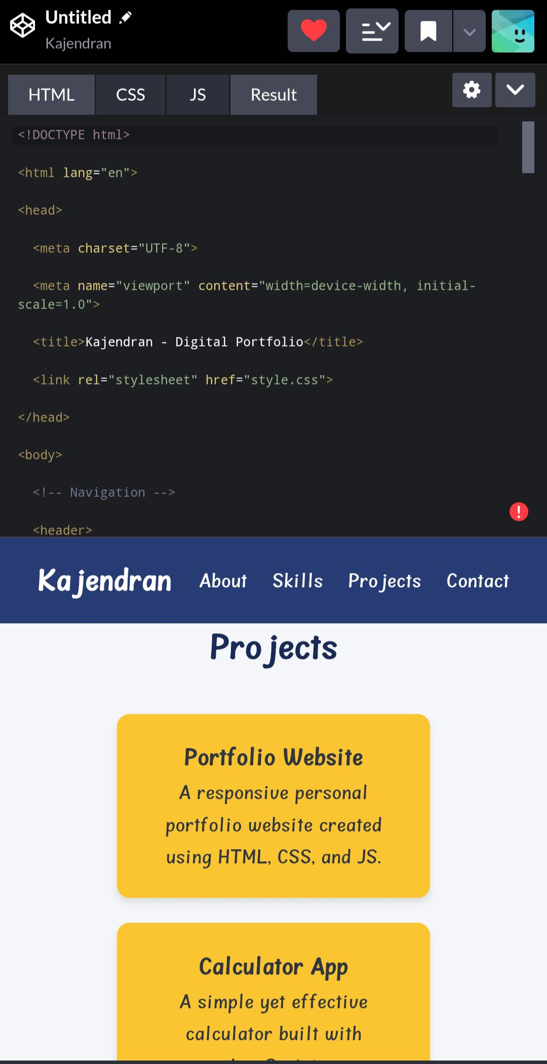

RESULTS AND SCREENSHOTS
3/21/2024 Annual Review
10

Slide 11
CONCLUSION
This portfolio serves as a versatile platform for professional presentation, highlighting both design sensibilities and technical skills. It reflects a commitment to continuous learning and effective communication through a well-organized digital presence.
11

